Slide 1
Clustering Analysis Basics
Ke Chen

Slide 2
Outline
Introduction
Data Types and Representations
Distance Measures
Major Clustering Approaches
Summary

Slide 3
Introduction
Cluster: A collection/group of data objects/points
  similar (or related) to one another within the same group
  dissimilar (or unrelated) to the objects in other groups
Cluster analysis
  find similarities between data according to characteristics underlying the data and grouping similar data objects into clusters
Clustering Analysis: Unsupervised learning
  no predefined classes for a training data set
  Two general tasks: identify the “natural” clustering number and properly grouping objects into “sensible” clusters
Typical applications
  as a stand-alone tool to gain an insight into data distribution
  as a preprocessing step of other algorithms in intelligent systems

Slide 4
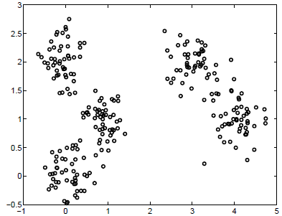
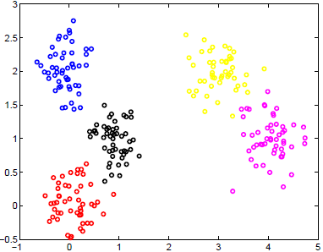
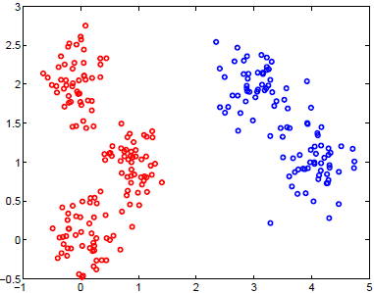
Introduction
Illustrative Example 1: how many clusters?

Slide 5
Introduction
Illustrative Example 2: are they in the same cluster?
Blue shark,
sheep, cat,
dog
Lizard, sparrow, viper, seagull, gold fish, frog, red mullet
Two clusters
Clustering criterion:
How animals bear
their progeny
Gold fish, red mullet, blue shark
Sheep, sparrow,
dog, cat, seagull,
lizard, frog, viper
Two clusters
Clustering criterion:
Existence of lungs

Slide 6
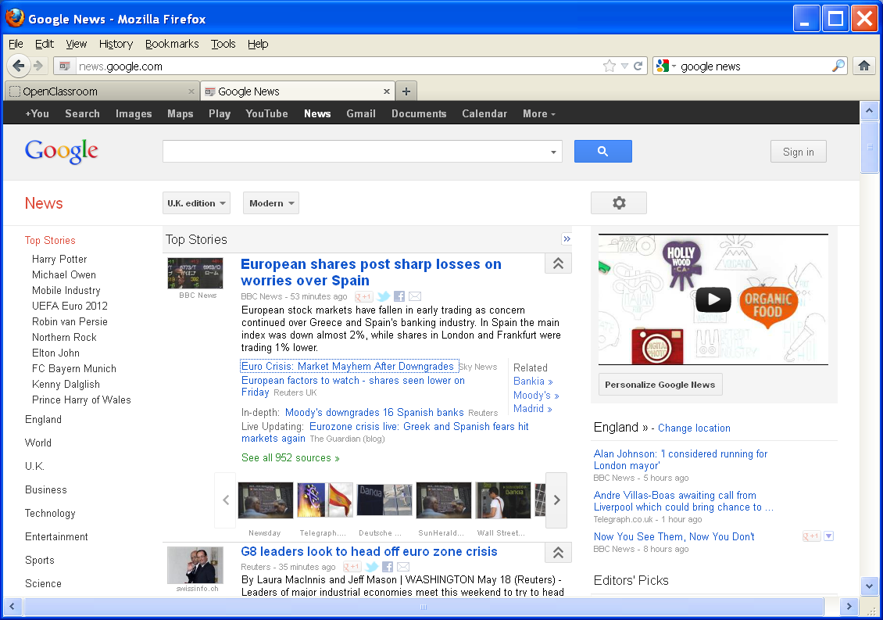
Introduction
Real Applications: Google News

Slide 7
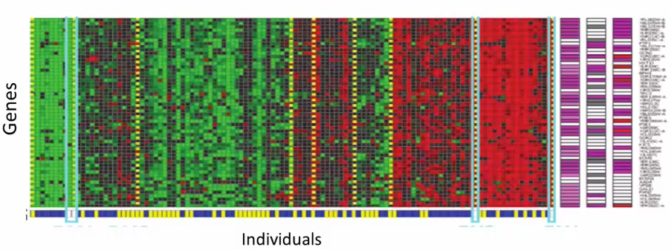
Introduction
Real Applications: Genetics Analysis

Slide 8
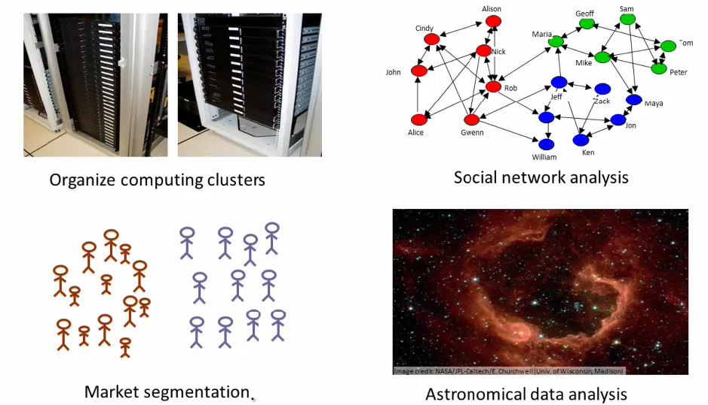
Introduction
Real Applications: Emerging Applications
Notes:
Server clustering
Grouping customers based on their favours
Social networks: discover close-knit cluster
Use galaxy cluster to study universal mass

Slide 9
Introduction
A technique demanded by many real world tasks
  Bank/Internet Security: fraud/spam pattern discovery
  Biology: taxonomy of living things such as kingdom, phylum, class, order, family, genus and species
  City-planning: Identifying groups of houses according to their house type, value, and geographical location
  Climate change: understanding earth climate, find patterns of atmospheric and ocean
  Finance: stock clustering analysis to uncover correlation underlying shares
  Image Compression/segmentation: coherent pixels grouped
  Information retrieval/organisation: Google search, topic-based news
  Land use: Identification of areas of similar land use in an earth observation database
  Marketing: Help marketers discover distinct groups in their customer bases, and then use this knowledge to develop targeted marketing programs
  Social network mining: special interest group automatic discovery

Slide 10
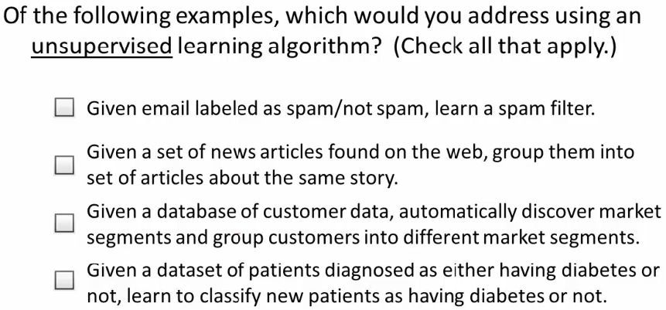
Quiz
√
√

Slide 11
Data Types and Representations
Discrete vs. Continuous
  Discrete Feature
    Has only a finite set of values
    e.g., zip codes, rank, or the set of words in a collection of documents
    Sometimes, represented as integer variable
  Continuous Feature
    Has real numbers as feature values
    e.g, temperature, height, or weight
    Practically, real values can only be measured and represented using a finite number of digits
    Continuous features are typically represented as floating-point variables

Slide 12


Data Types and Representations
Data representations
  Data matrix (object-by-feature structure)
  Distance/dissimilarity matrix (object-by-object structure)
n data points (objects) with p dimensions (features)
Two modes: row and column represent different entities
n data points, but registers only the distance
A symmetric/triangular matrix
Single mode: row and column for the same entity (distance)

Slide 13
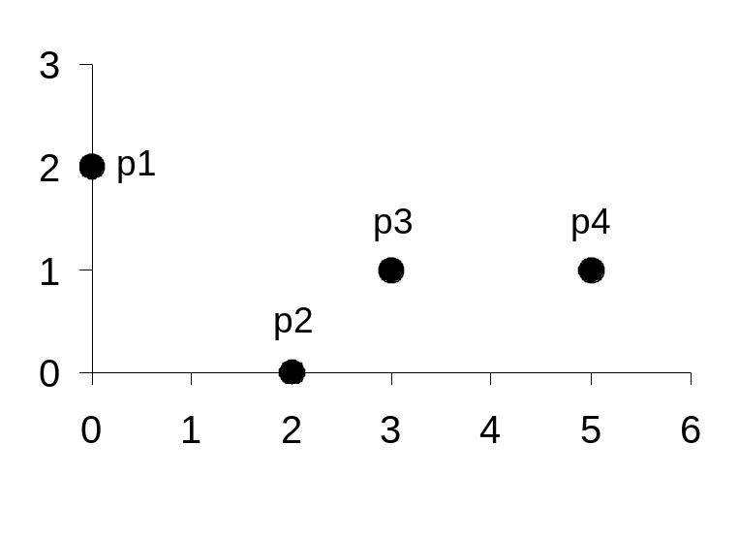
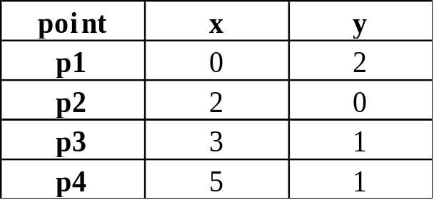
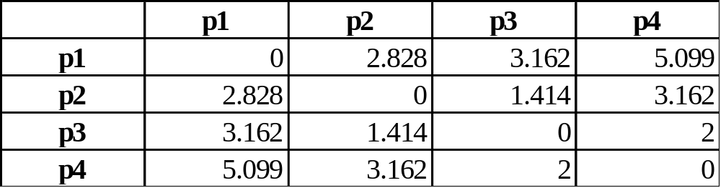
Data Types and Representations
Examples
Data Matrix
Distance Matrix (i.e., Dissimilarity Matrix) for Euclidean Distance

Slide 14
Distance Measures
Minkowski Distance (http://en.wikipedia.org/wiki/Minkowski_distance)
  For
  p = 1: Manhattan (city block) distance
  p = 2: Euclidean distance
  Do not confuse p with n, i.e., all these distances are defined based on all numbers of features (dimensions).
  A generic measure: use appropriate p in different applications
Notes:
|.|: modulus or absolute value of a real number
See unit circles for different p values from the wikipedia, any points on the boundary of a unit circle are those whose distance to the origin is one; i.e., d(x, 0) = 1.

Slide 15
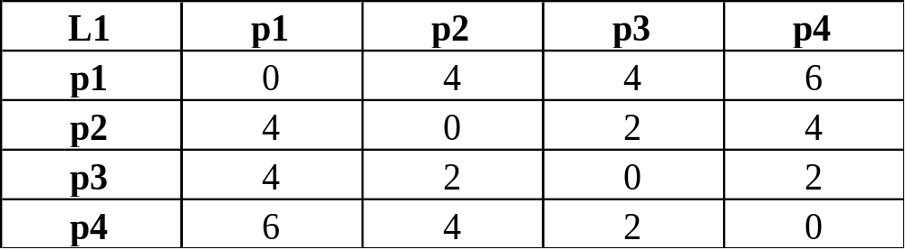
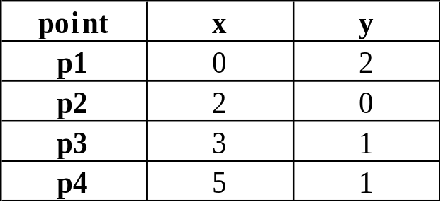
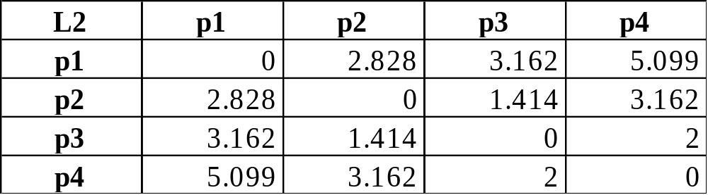
Distance Measures
Example: Manhatten and Euclidean distances
Distance Matrix for Manhattan Distance
Data Matrix
Distance Matrix for Euclidean Distance

Slide 16
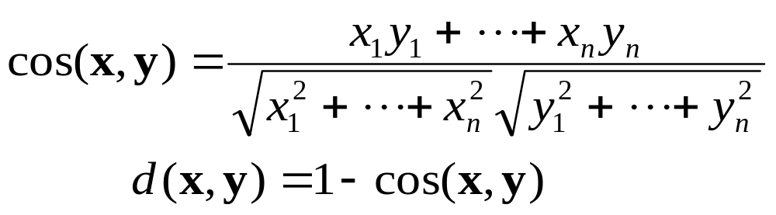
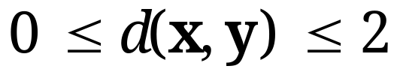
Distance Measures
Cosine Measure (Similarity vs. Distance)
  For
  Property:
  Nonmetric vector objects: keywords in documents, gene features in micro-arrays, …
  Applications: information retrieval, biologic taxonomy, ...
Notes:
Explain the notation cos(x,y)

Slide 17
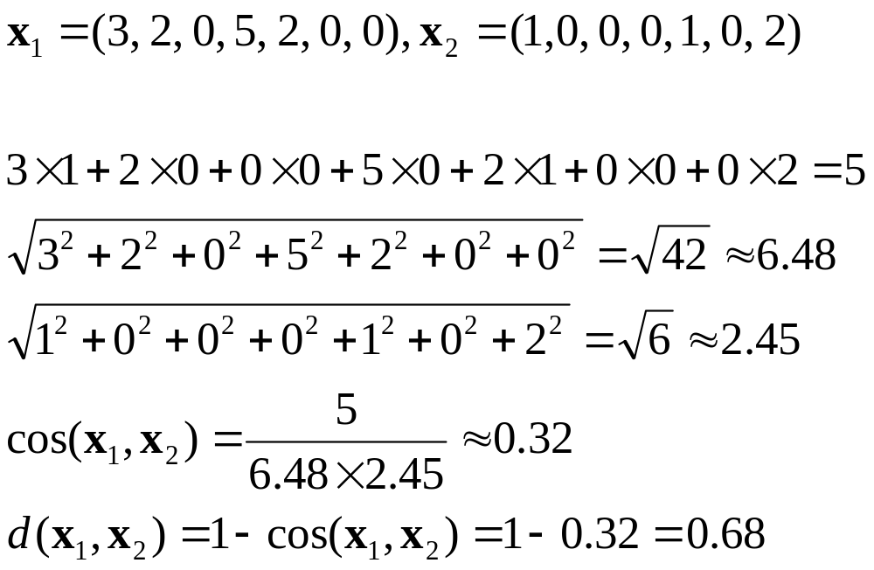
Distance Measures
Example: Cosine measure

Slide 18


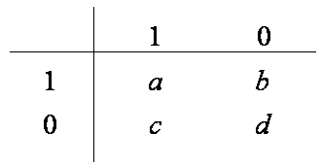
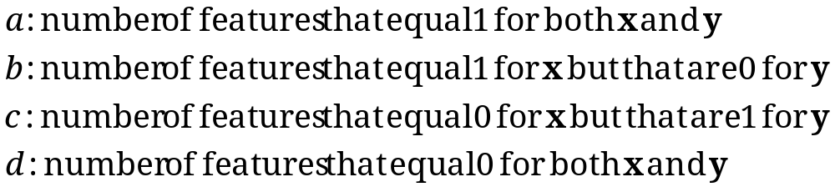
Distance Measures
Distance for Binary Features
  For binary features, their value can be converted into 1 or 0.
  Contingency table for binary feature vectors, and

Slide 19
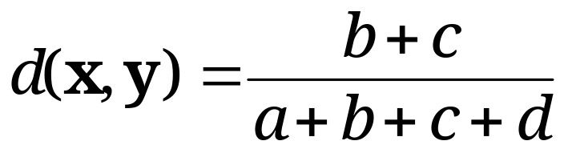
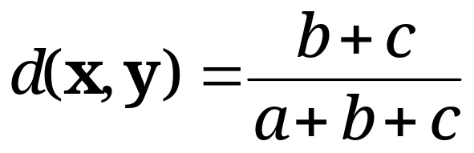
Distance Measures
Distance for Binary Features
  Distance for symmetric binary features
    Both of their states equally valuable and carry the same weight; i.e., no preference on which outcome should be coded as 1 or 0 , e.g. gender
  Distance for asymmetric binary features
    Outcomes of the states not equally important, e.g., the positive and negative outcomes of a disease test ; the rarest one is set to 1 and the other is 0.

Slide 20
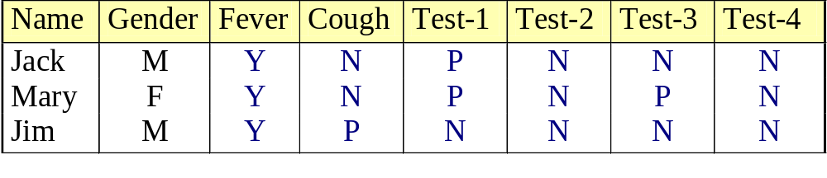
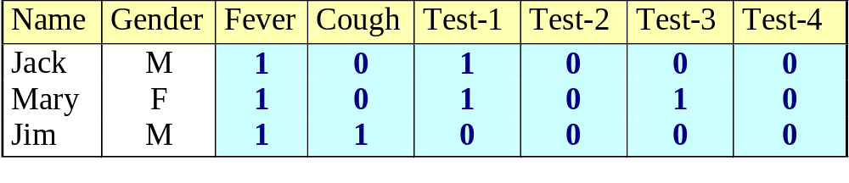
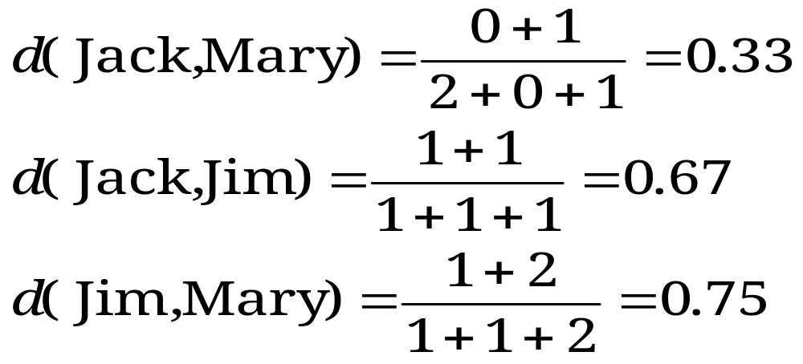
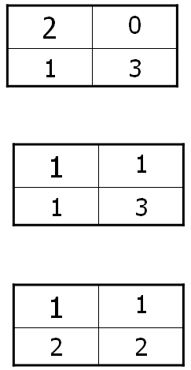
Distance Measures
Example: Distance for binary features
  gender is a symmetric feature (less important)
  the remaining features are asymmetric binary
  set the values “Y” and “P” to 1, and the value “N” to 0
“Y”: yes
“P”: positive
“N”: negative
Mary
Jack
Jim
Jack
Mary
Jim

Slide 21
Distance Measures
Distance for nominal features
  A generalization of the binary feature so that it can take more than two states/values, e.g., red, yellow, blue, green, ……
  There are two methods to handle variables of such features.
    Simple mis-matching
    Convert it into binary variables
    creating new binary features for all of its nominal states
    e.g., if an feature has three possible nominal states: red, yellow and blue,
    then this feature will be expanded into three binary features accordingly.
    Thus, distance measures for binary features are now applicable!

Slide 22
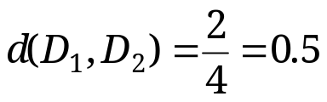
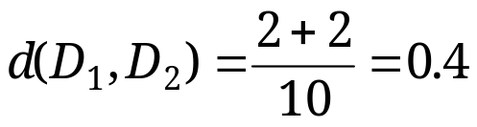
Distance Measures
Distance for nominal features (cont.)
  Example: Play tennis
    Simple mis-matching
    Creating new binary features
      Using the same number of bits as those features can take
 | Outlook | Temperature | Humidity | Wind
D1 | Overcast | High | High | Strong
D2 | Sunny | High | Normal | Strong
 | Outlook | Temperature | Humidity | Wind
D1 | 010 | 100 | 10 | 10
D2 | 100 | 100 | 01 | 10
Outlook = {Sunny, Overcast, Rain} (100, 010, 001)
Temperature = {High, Mild, Cool} (100, 010, 001)
Humidity = {High, Normal} (10, 01)
Wind = {Strong, Weak} (10, 01)

Slide 23

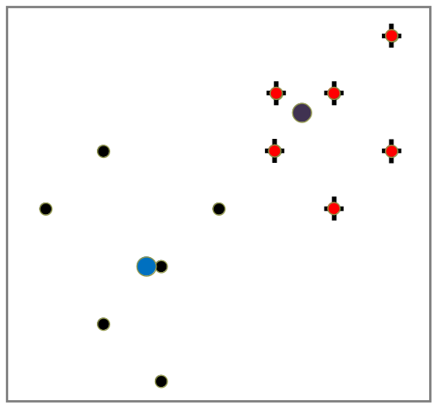
Major Clustering Approaches
Partitioning approach
  Construct various partitions and then evaluate them by some criterion, e.g., minimizing the sum of square distance cost
  Typical methods: k-means, k-medoids, CLARANS, ……

Slide 24
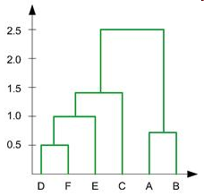
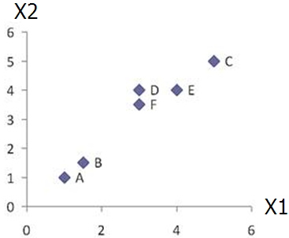
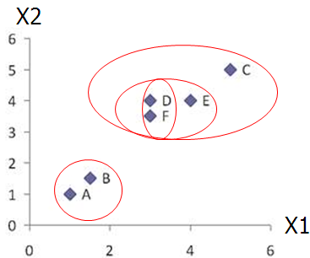
Major Clustering Approaches
Hierarchical approach
  Create a hierarchical decomposition of the set of data (or objects) using some criterion
  Typical methods: Agglomerative, Diana, Agnes, BIRCH, ROCK, ……

Slide 25
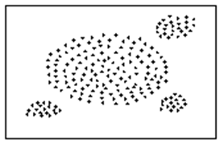
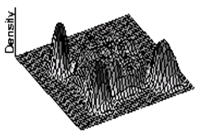
Major Clustering Approaches
Density-based approach
  Based on connectivity and density functions
  Typical methods: DBSACN, OPTICS, DenClue, ……

Slide 26
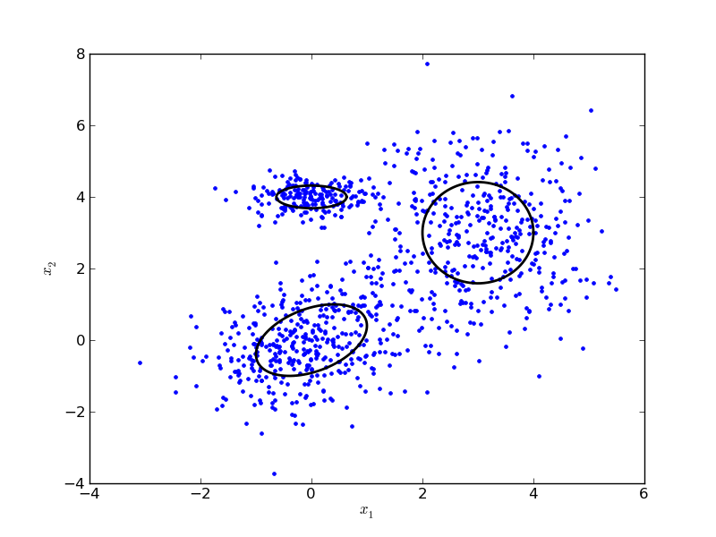
Major Clustering Approaches
Model-based approach
  A generative model is hypothesized for each of the clusters and tries to find the best fit of that model to each other
  Typical methods: Gaussian Mixture Model (GMM), COBWEB, ……

Slide 27
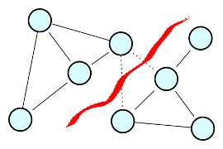
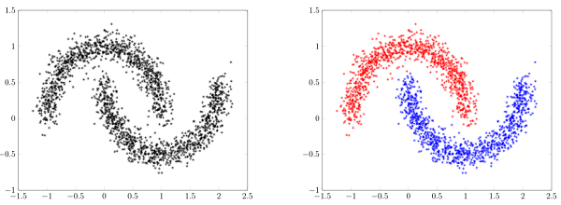
Major Clustering Approaches
Spectral clustering approach
  Convert data set into weighted graph (vertex, edge), then cut the graph into sub-graphs corresponding to clusters via spectral analysis
  Typical methods: Normalised-Cuts ……

Slide 28
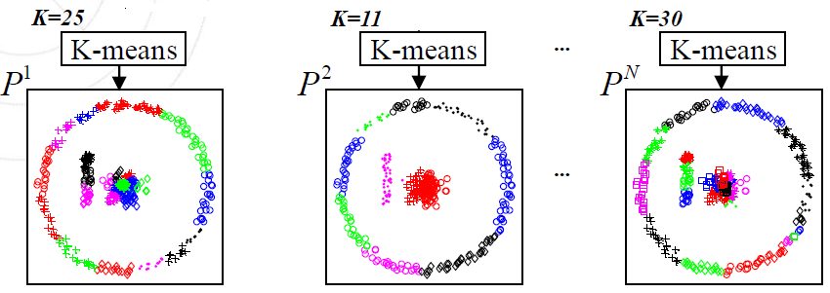
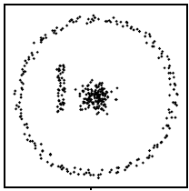
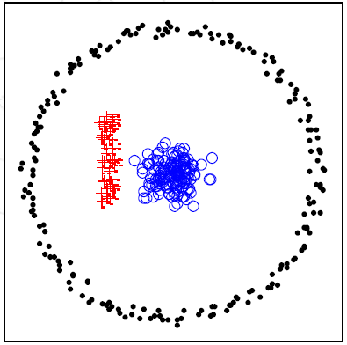
Major Clustering Approaches
Clustering ensemble approach
  Combine multiple clustering results (different partitions)
  Typical methods: Evidence-accumulation based, graph-based ……
combination

Slide 29
Summary
Clustering analysis groups objects based on their (dis)similarity and has a broad range of applications.
Measure of distance (or similarity) plays a critical role in clustering analysis and distance-based learning.
Clustering algorithms can be categorized into partitioning, hierarchical, density-based, model-based, spectral clustering as well as ensemble approaches.
There are still lots of research issues on cluster analysis;
  finding the number of “natural” clusters with arbitrary shapes
  dealing with mixed types of features
  handling massive amount of data – Big Data
  coping with data of high dimensionality
  performance evaluation (especially when no ground-truth available)

